Slide 1

Group Members: Arslan Ali 01-243211-002 Shahid Hussain 01-243211-009 Arsalan Akram 01-243202-010
Pedestrian Detection

Slide 2
Introduction
Pedestrian detection is an essential and significant task in any intelligent video surveillance system, as it provides the fundamental information for semantic understanding of the video footages.

Slide 3
Why pedestrian detection Needed?
To detect vulnerable Pedestrian
Safe driving assistant Navigation
To solve pedestrian Traffic & safety
To analyze study & behavior of pedestrians
Balance between pedestrian & vehicle to improve road capacity
Use to monitor parking lots ,stations, shopping malls,bank,sensitive
Save a lot of manpower & material resources

Slide 4
Methodology..
Monocular Vision
pedestrian detection module
pedestrian tracking module
Deep learning techniques including
RCNN – Region based convolutional neural network(slower)
YOLO – you only look once, real time object detection (less accurate)
SSD – single shot detector ,predict boundary boxes (faster & accurate)

Slide 5
Haar-cascade classifier
Detect, track, count pedestrians with the help of image processing
Takes the frames from the CCTV video stream
Haar-cascade classifier
Result as detected pedestrians with bounding box
Use of SORT, tracked pedestrians with unique IDs
Tracked pedestrian’s IDs and locations as well as Region of Interest (ROI) (Waiting time calculation

Slide 6
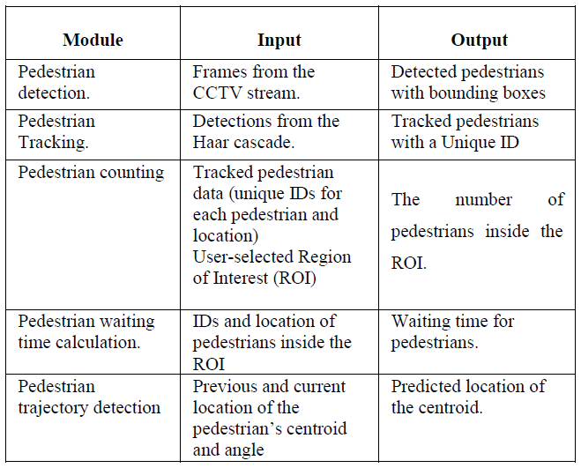

Slide 7
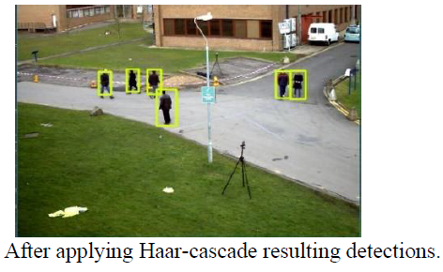
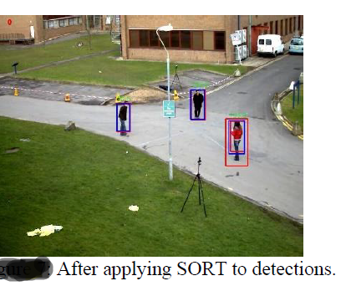
Results after applying Haar-cascade classifier and the SORT on those detections

Slide 8
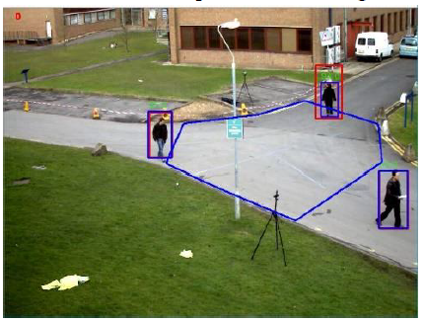
Pedestrian counting and waiting time calculation
Coordinates of the detected, tracked pedestrians and (ROI) which is marked by the user
Users can mark this ROI and save it
Check whether pedestrian coordinates are inside the ROI or outside the ROI and makes a list of pedestrians

Slide 9
Conclusion
The proposed technologies are ideal to detect pedestrian for real time applications as well as to detect the moving pedestrian from fixed scene & track the movement of pedestrians. After applying those techniques pedestrian speed, their waiting time, vulnerabilities , and movement can be monitored which is very essential in this populated world.

Slide 10
Future work
Detection part can be improved
Quantum technologies can be used to increased speed and accuracy .
Voting system (highest number of pedestrian on location)

Slide 11
References
Pedestrian Detection,Tracking,Counting,Waiting Time Calculation and Trajectory Detection for Pedestrian Crossings Traffic light systems.
Enhanced Vulnerable Pedestrian Detection using Deep Learning
Pedestrian Detection based on monocular vision

Slide 12

Thankyou
Questions & Answers

